Slide 1
Retirement Systems update
Senate Finance Retirement Systems Standing Subcommittee
March 30, 2021

Slide 2
Roles in managing the Systems
PEBA operates and administers the state’s retirement programs, which were created and are defined by state statute.
The S.C. General Assembly has authority to make changes to the laws that govern these retirement plans.
South Carolina Retirement Systems.
State Optional Retirement Program.
South Carolina Deferred Compensation Program.

Slide 3
PEBA’s retirement plans
Defined benefit plans:
South Carolina Retirement System (SCRS).
Police Officers Retirement System (PORS).
General Assembly Retirement System (GARS).
Judges and Solicitors Retirement System (JSRS).
South Carolina National Guard Supplemental Retirement Plan (SCNG).
Defined contribution plan:
State Optional Retirement Program (State ORP).
Voluntary, supplemental retirement savings plan:
South Carolina Deferred Compensation Program.

Slide 4
Past pension reform
Benefit reform was done in 2012.
Funding reform was done in 2017.

Slide 5
Act 278 of 2012
Created Class Three tier of membership in SCRS and PORS for newly hired employees with membership dates on or after July 1, 2012.
Increased service requirements for retirement with full benefits
Rule of 90 for SCRS; 27 years of service for PORS.
Age-based retirement requirements were unchanged.
Increased vesting period from five years to eight years.
Changed average final compensation calculations from 12 quarters of highest earnable compensation to 20 quarters.
Removed credit for unused annual and sick leave at retirement from benefit calculations.

Slide 6
Act 278 of 2012
Changes affecting Class Two and Three members:
Closed TERI program effective June 30, 2018.
Changed cost of service purchase to be actuarially neutral.
Excluded pay for non-mandatory overtime from SCRS earnable compensation.
Changed eligibility for SCRS disability retirement.
Eliminated interest on inactive accounts.

Slide 7
Act 278 of 2012
Changes affecting retirees:
Limited annual benefit adjustment, formally referred to as a COLA, to 1 percent up to a maximum of $500 annually.
Added $10,000 earnings limit for members who retired after January 1, 2013, and return to work for a covered employer, unless the member was over age 62 (SCRS) or age 57 (PORS) at retirement.
Other exceptions to the earnings limitation include compensation from certain elected and appointed offices and for certain critical needs positions in public schools.
Closed GARS to newly elected officials after the general election of 2012; new members may join SCRS or State ORP.

Slide 8
Retirement System Funding and Administration Act of 2017
Legislation did not change the benefits provided to members of the Retirement Systems.
Goal of the legislation was to pay down the unfunded liability faster by:
Reducing the funding period;
Increasing contribution rates; and
Decreasing the negative amortization.
Decreased the assumed rate of return from 7.5 percent to 7.25 percent effective July 1, 2017.
Rate will remain in effect through July 1, 2021, at which time a new rate will be set by the General Assembly.
PEBA provides a proposed rate based upon a recommendation from the systems actuary and in consultation with RSIC.

Slide 9
Retirement System Funding and Administration Act of 2017
Changed employee and employer contribution rates effective July 1, 2017.
SCRS employee rate was increased to and capped at 9 percent.
PORS employee rate was increased to and capped at 9.75 percent.
Employer rates for SCRS and PORS increased by 2 percent. A schedule of rates includes additional 1 percent increases annually through July 1, 2022.
The General Assembly provided funding in fiscal years 2018, 2019, 2020 and 2021 for credits towards employer contributions for most employers participating in SCRS and PORS.

Slide 10
Retirement System Funding and Administration Act of 2017
Gradually reduced the maximum funding period from 30 years to 20 years by July 1, 2027.
Schedule reflects a one year reduction in the funding period for each of the next 10 years, but also allows for future unforeseen investment losses.
The legislation took several important steps to increase funding to the Retirement Systems, which improves the financial condition of the plans more quickly and incorporates a cushion for possible future adverse investment experience.

Slide 11
Summary of July 1, 2020, SCRS and PORS valuation results
Amounts expressed in millions
 | SCRS |  | PORS
 | 2020 | 2019 | 2020 | 2019
Actuarial accrued liability | $52,061 | $50,439 | $8,112 | $7,737
Actuarial (smoothed) value assets | $28,172 | $27,444 | $5,070 | $4,854
Unfunded liability (UAAL) | $23,889 | $22,995 | $3,042 | $2,885
Funded ratio | 54% | 54% | 63% | 63%
Member contribution rate | 9.00% | 9.00% | 9.75% | 9.75%
Employer contribution rate next FY | 16.56% | 15.56% | 19.24% | 18.24%
Total contribution rate | 25.56% | 24.56% | 28.99% | 27.99%
Calculated funding period Based on FY 2022 contribution rates | 20 years | 23 years | 18 years | 20 years
Expected contributions (actual for prior year)
Member | $924 | $923 | $152 | $152
Employer | $1,788 | $1,737 | $284 | $276

Slide 12
SCRS unfunded liability as of June 30, 2020
 | Market value $25.769 billion | Actuarial value $23.889 billion
Investment experience | $10.513 billion | $10.513 billion
Deferred investment losses | $1.880 billion | Not applicable
Interest on the unfunded actuarial accrued liability (UAAL) | $3.715 billion | $3.715 billion
COLAs | $3.312 billion | $3.312 billion
Non-COLA benefit changes | $63 million | $63 million
Liability experience | $2.420 billion | $2.420 billion
Assumption changes | $3.866 billion | $3.866 billion

Slide 13
SCRS contribution schedule set by Retirement System Funding and Administration Act of 2017
Fiscal year | Scheduled employer contribution | Actual employer contribution | Employee contribution | Maximum amortization period
2017 | 11.56% | 11.56% | 8.66%
2018 | 13.56% | 13.56% | 9.00% | 30 years
2019 | 14.56% | 14.56% | 9.00% | 29 years
2020 | 15.56% | 15.56% | 9.00% | 28 years
2021 | 16.56% | 15.56% | 9.00% | 27 years
2022 | 17.56% |  | 9.00% | 26 years
2023 | 18.56% |  | 9.00% | 25 years
2028 | 18.56% |  | 9.00% | 20 years
The General Assembly included a provision in its continuing resolution suspending the statutory employer contribution rate increase for all of fiscal year 2021. As such, it is expected that the scheduled time period for employer contribution rate increases will be extended.
Rates include incidental death benefit contributions when applicable.

Slide 14
PORS contribution schedule set by Retirement System Funding and Administration Act of 2017
Fiscal year | Scheduled employer contribution | Actual employer contribution | Employee contribution | Maximum amortization period
2017 | 14.24% | 14.24% | 9.24%
2018 | 16.24% | 16.24% | 9.75% | 30 years
2019 | 17.24% | 17.24% | 9.75% | 29 years
2020 | 18.24% | 18.24% | 9.75% | 28 years
2021 | 19.24% | 18.24% | 9.75% | 27 years
2022 | 20.24% |  | 9.75% | 26 years
2023 | 21.24% |  | 9.75% | 25 years
2028 | 21.24% |  | 9.75% | 20 years
The General Assembly included a provision in its continuing resolution suspending the statutory employer contribution rate increase for all of fiscal year 2021. As such, it is expected that the scheduled time period for employer contribution rate increases will be extended.
Rates include incidental death benefit and Accidental Death Program contributions when applicable.

Slide 15
Effects of 2017 legislation on SCRS
While the UAAL has continued to rise, the additional contributions required by the 2017 legislation have reduced the funding period. If actuarial assumptions are met, the funding period is expected to shorten over time. The actual reduction in the amortization period will depend upon emerging experience, including investment experience.

Slide 16
Test comparing multiple outcomes over different time horizons
Slide content from GRS, the Retirement Systems’ actuary and assumes the investment return assumption will be 7% on and after 2021.

Slide 17
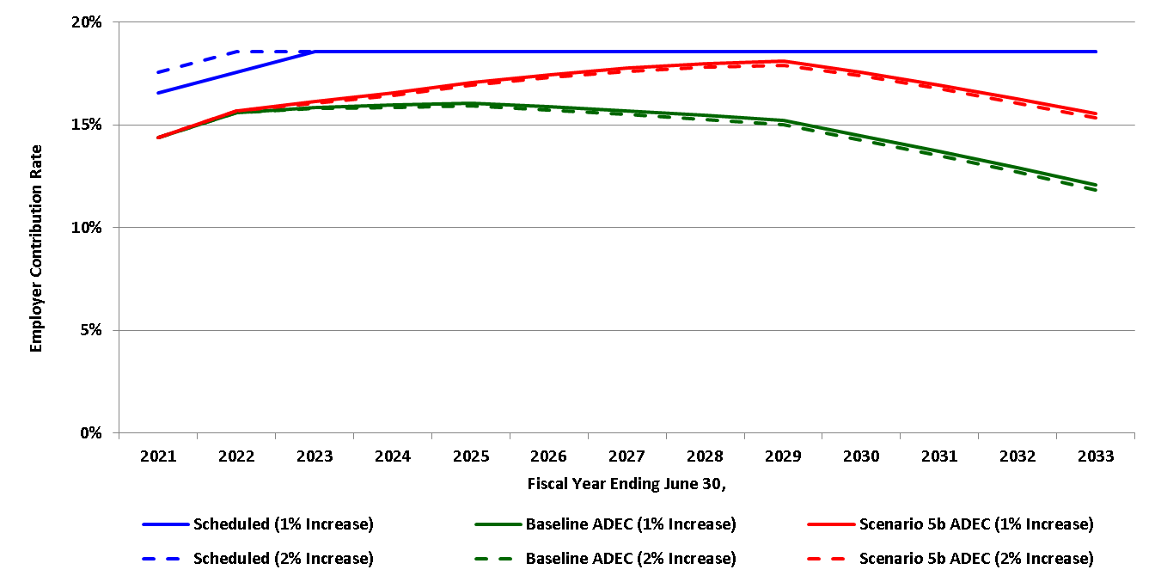
SCRS projected contribution rates for legislative decision making (Scenario 5b)
A 1% or 2% scheduled increase to the contribution rate in FY 2021 (with additional 1% increases until the ultimate scheduled rate is attained) is projected to be sufficient to maintain the maximum permitted funding period under these scenarios.
Projection provides the impact of a 1% versus 2% contribution rate increase in FY 2021 with additional increases until the ultimate scheduled rate is attained. The projection also reflects the recommended demographic and economic assumptions starting in 2021 (including a 7% return assumption). Scenario 5b assumes emerging investment experience is 4% for each of the next five years and 7% each year thereafter.

Slide 18
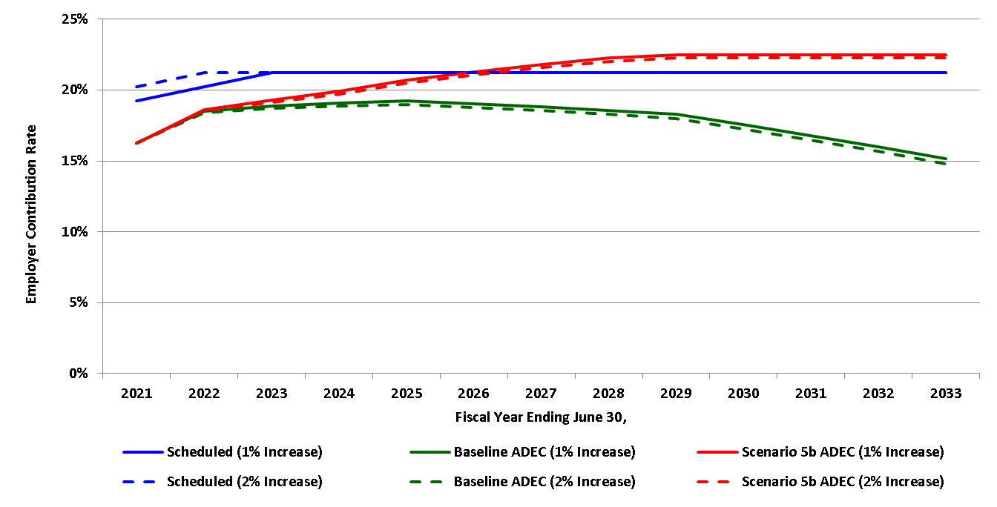
PORS projected contribution rates for legislative decision making (Scenario 5b)
Scheduled contribution rates are projected to increase in FY 2026 under Scenario 5b.
Projection provides the impact of a 1% versus 2% contribution rate increase in FY 2021 with additional increases until the ultimate scheduled rate is attained. The projection also reflects the recommended demographic and economic assumptions starting in 2021 (including a 7% return assumption). Scenario 5b assumes emerging investment experience is 4% for each of the next five years and 7% each year thereafter.

Slide 19
Potential solutions for SCRS funding concerns
There are two types of potential solutions to help address funding issues for SCRS:
Changes to funding methods to pay down liabilities that are already accrued; and
Changes to plan design to mitigate the accrual of future liabilities.

Slide 20
Plan design change options
Close SCRS to new entrants and open a defined contribution plan.
Advantages:
There would be no unfunded liability related to members in a defined contribution plan, although the current unfunded liability would remain and will require payment.
No state-held investment risk.
No risk of rising contribution rates for new employees and their employers with a defined contribution plan; however, payments required for the existing defined benefit plan may continue to grow.
Availability of retirement investment choices for employees. This may also be considered a disadvantage, as employees are required to make investment decisions whether or not they want to do so.
Disadvantages:
Closing SCRS does nothing to reduce existing unfunded liability. The benefits obligations of current retirees account for 61 percent of the entire UAAL.
The elimination of new employees paying into the plan would create a cash-flow issue for SCRS and its current members. Investment returns could decline, causing additional cash-flow issues.
The loss of a defined benefit plan and its more certain retirement income, which is a substantial attraction for public sector jobs, could reduce the ability of public employers to recruit and retain a strong workforce.
Increased legal risk from potential litigation filed in response to a plan closure.
No disability benefits.

Slide 21
Plan design change options
Close SCRS to new entrants and open a hybrid defined benefit/defined contribution plan.
Advantages:
Risks which would be removed with a defined contribution plan can be reduced but not eliminated with a hybrid plan. These include the risk of growing the unfunded liability, state-held investment risk and risk of rising contribution rates.
Hybrid plans, like defined contribution plans, provide employees with greater availability of retirement investment choices.
Disadvantages:
As with the replacement of SCRS for new employees with a defined contribution plan, replacing SCRS for new employees with a hybrid plan does not reduce the current unfunded liability, and can lead to a cash-flow concern for SCRS with declining investment returns.
Increased legal risk from potential litigation filed in response to a plan closure.
Other drawbacks of a defined contribution plan also exist in reduced form for a hybrid plan, such as reduction of retirement benefit certainty as a recruitment tool.

Slide 22
Other considerations
Inherent risk.
All considerations of SCRS’ future must take into account that no projection can provide absolute certainty of future plan experience. The actual rate of return going forward always remains subject to change, as do other factors like payroll growth and life expectancy.
Workforce recruitment and retention.
The current defined benefit plan structure, which offers a more certain retirement income, is an influential recruitment tool for public sector employers. Changes to plan design could reduce the ability of public employers to recruit and retain a strong workforce.
Legal risk.
There are potential legal risks associated with funding method and plan design changes including potential litigation filed in response to a plan closure. Any proposed changes should be properly vetted through legal counsel to determine potential risks.

Slide 23
FY 2020 total annual compensation by employer type for SCRS
Includes active employees, State ORP participants and return-to-work retirees
Amounts expressed in thousands
Optional employers
578 employers $2,682,426
Includes cities, counties and other local subdivisions of government.
State agencies and higher education institutions
119 employers $4,073,832
$11.52 billion
School districts
118 employers $4,764,950

Slide 24
Contributions effective July 1, 2020
Defined benefit participant (SCRS)
 | Normal cost |  | Unfunded liability |  | Total
Member | 9.00% | + | - | = | 9.00%
Employer | 1.63% | + | 13.93% | = | 15.56%
Total | 10.63% | + | 13.93% | = | 24.56%
Defined contribution participant (State ORP)
 | Member account |  | Unfunded liability |  | Total
Member | 9.00% | + | - | = | 9.00%
Employer | 5.00% | + | 10.56% | = | 15.56%
Total | 14.00% | + | 10.56% | = | 24.56%

Slide 25
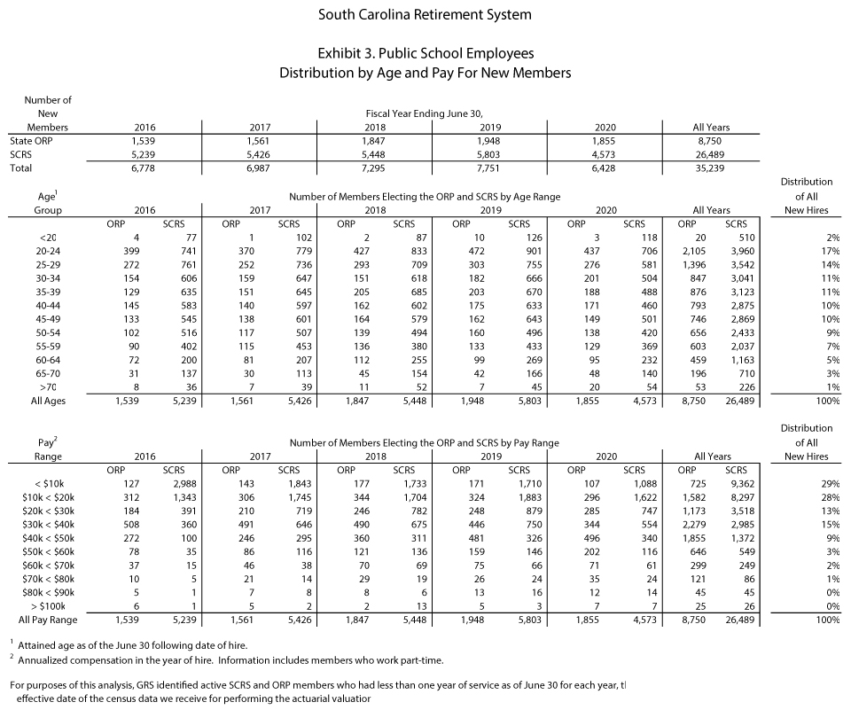

Slide 26
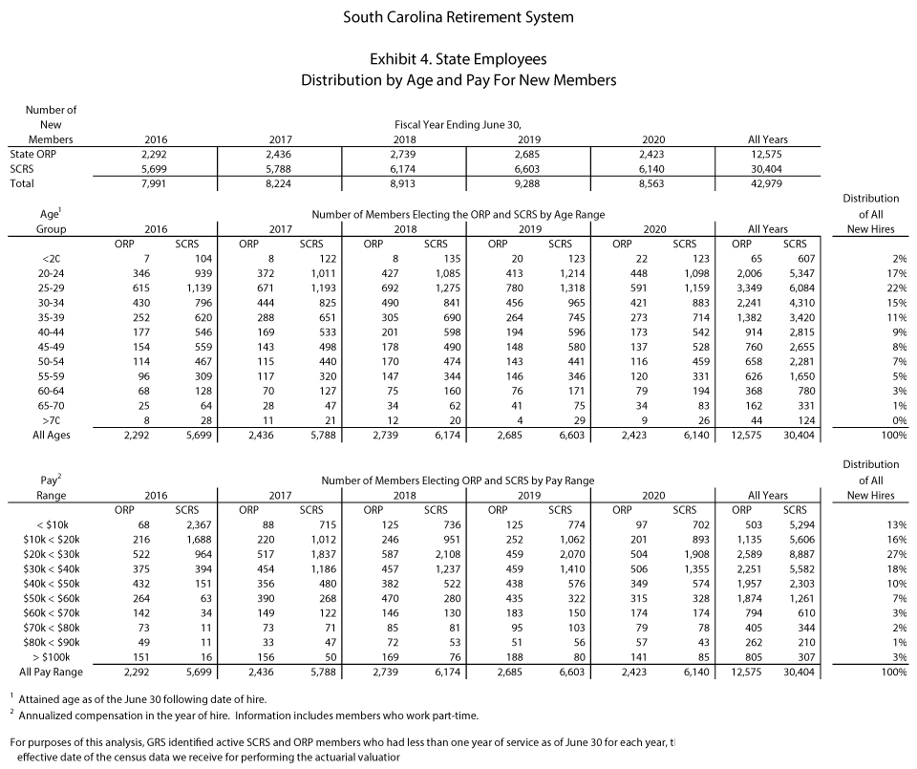

Slide 27
What is the earnings limitation?
Provisions do not actually limit the ability of a retiree to return to covered employment or restrict the amount of compensation a retiree may receive; provisions are limitations on the receipt of benefits.
Once a member earns more than $10,000 in a calendar year from covered employment, his retirement benefit is suspended for the remainder of the year. His retirement benefit payments will be reinstated the next January.
Benefit will be reinstated before the next January if he terminates covered employment before the end of the year.

Slide 28
What is the earnings limitation?
Earnings limitation was put into place to encourage members to delay the start of their monthly retirement benefit.
The TERI program and generous return-to-work provisions encouraged members to retire earlier than expected, resulting in additional costs to the plan.

Slide 29
Earnings limitation
Contribution and benefit structures are designed to provide a retirement benefit that replaces a portion of a member’s income after retirement.
Ability to return to covered employment after retirement without affecting benefits incentivizes members to retire earlier than they would have without the availability of unlimited post-retirement employment.
Acceleration of members’ retirement dates has a cost to the systems because it results in the systems paying benefits earlier and longer than would otherwise be expected.
Earnings limitation is intended to remove incentives.

Slide 30
To whom does the earnings limitation apply?
Members who retire on or after January 2, 2013, and are younger than age 62 (SCRS) or age 57 (PORS) on the date of retirement, unless they meet an exception:
Retired before January 2, 2013, regardless of age at retirement.
Retirement after age 62 (SCRS) or age 57 (PORS).
Compensation from certain public offices.
Compensation from certain critical needs positions in the school system.
Compensation when a PORS member who retired on or before December 31, 2017, returns to covered employment if he is a Class 1 law enforcement officer and returns to work with a public school district as a critical needs school resource officer.
SCRS and PORS members who return to covered employment to participate in the state's public health preparedness and response to the COVID-19 virus.

Slide 31
Other return-to-work considerations
Member must have a complete, bona fide termination from all covered employment to retire and begin receiving a monthly benefit.
If member returns to covered employment sooner than 30 consecutive calendar days after retirement, he is not eligible to receive his benefit until the separation requirements are satisfied.
If an employer fails to notify PEBA when it hires a retired member, the employer may be responsible for reimbursing the retirement systems for any benefits wrongly paid to the retired member.

Slide 32
Pension reform in other states
Since 2009, nearly every state has passed reform to one or more of its pension plans.
Most common types of pension reform:
Employees are required to pay more.
Benefits are reduced.
Cost-of-living adjustments are reduced.
Employees are required to work longer.
Decision to retain traditional pension plan.

Slide 33
Contribution rate comparison for general employee plans
According to the National Association of State Retirement Administrators (NASRA), the median employer contribution rate was 14.7% of pay and the median employee contribution rate was 6.25% of pay for fiscal year 2019 for general employee and teacher plans that are also covered by Social Security.
National median contribution rates for fiscal year 2019 from NASRA, November 2020.

Slide 34
Contribution rate comparison for public safety plans
According to the National Association of State Retirement Administrators (NASRA), the median employer contribution rate was 21.7% of pay and the median employee contribution rate was 8% of pay for fiscal year 2018 for public safety plans that are also covered by Social Security.
National median employee contribution rate for fiscal year 2018 from NASRA, December 2019. National median employee contribution rate for fiscal year 2018 from NASRA Issue Brief, September 2019.

Slide 35
Actuarial assumptions
The external consulting actuaries make assumptions about future experience regarding member experience and investment experience. These assumptions are reevaluated every four years during an experience study and are presented to the PEBA Board of Directors for review and adoption.
The most recent experience study was completed in spring 2020. Completing an experience study ensures assumptions stay reasonable according to the professional standards of the actuaries.
The plans assume they will earn 7.25% each year. The plans had a negative return of -1.58% in fiscal year 2020; therefore, the plans experienced an actuarial loss of -8.83% in fiscal year 2020.
This does not mean the plans actually lost 8.83% in the investment market; it means that the plans didn’t earn as much as the actuarial assumptions estimated.
Because the plans are invested in financial markets, volatility of returns (variance in returns) is expected. However, the ups and downs are expected to even out over time.
For example, in fiscal year 2018, the plans earned 7.82%, compared to the 7.25% assumption, which was an actuarial gain.
The actuarial valuations recognize both gains and losses over time to account for the expected volatility. This process is called “smoothing.”
In the recent experience study, GRS recommends decreasing the actuarial rate of return from 7.25% to 7% when the current statutory rate expires June 30, 2021.

